Slide 1

COFFEE SALES DATA ANALYSIS
Maven Roasters

Slide 2
Goal: Build an interactive DASHBOARD TO EXPLORE AND ANALYZE COFFEE SHOP SALES to better understand purchase behavior and streamline operations.
(Limitations: for this analysis, we will only choose one store location to analyze and interpret.)

Slide 3
THE DATA: Transaction records for Maven Roasters, a fictitious coffee shop operating out of three NYC locations. Dataset includes the transaction date, timestamp and location, along with product-level details.

Slide 4
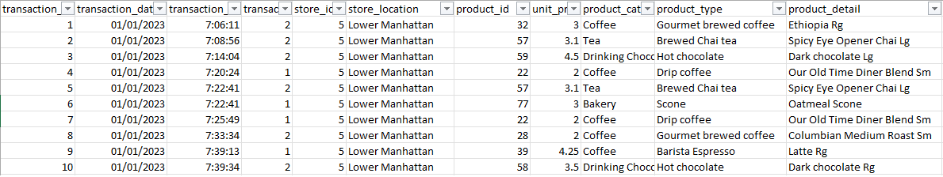
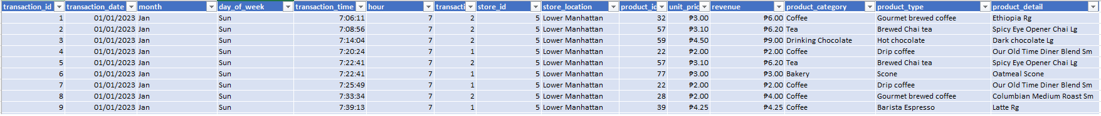
THE PROCESS: FROM THIS
TO THIS

Slide 5
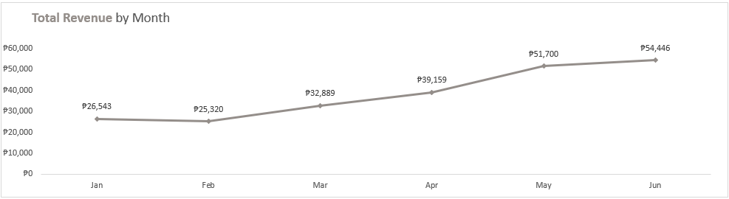
LOWER MANHATTAN
The revenue figures show a consistent increase from January to June, indicating a positive trend in sales over the first half of the year.

Slide 6
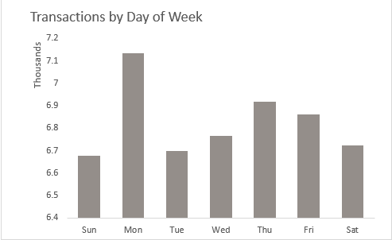
LOWER MANHATTAN
FINDINGS
Transaction data by day of the week indicates consistent activity throughout the week, with Mondays and Thursdays having slightly higher transaction counts compared to other days.
INSIGHTS
Consistent transaction activity throughout the week suggests stable customer behavior across different days, with peak transaction periods aligning with typical breakfast and afternoon tea times.

Slide 7
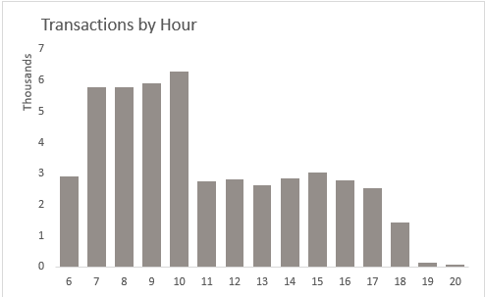
LOWER MANHATTAN
FINDINGS
Transactions by hour shows peak transaction hours between 7 AM and 10 AM and 3 PM with a notable drop during late evening.
INSIGHTS
Peak transaction hours in the morning and late afternoon indicate that customers are likely purchasing beverages during their morning commute and afternoon breaks, presenting opportunities for targeted promotions and menu offerings during these peak periods.

Slide 8
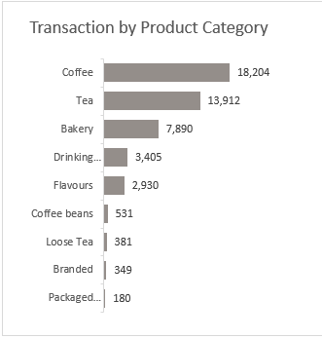
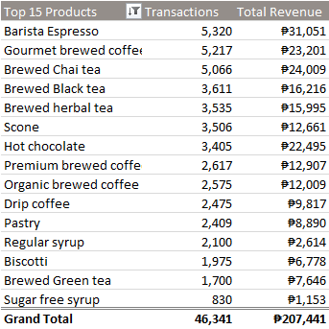
LOWER MANHATTAN
FINDINGS
Coffee is the top-selling product category, followed by Tea and Bakery items. Specialty beverages such as Barista Espresso, Gourmet brewed coffee, and Brewed Chai tea are among the top-selling products.
INSIGHTS
The dominance of Coffee as the top-selling product category underscores the importance of offering a diverse range of coffee options and specialty drinks to meet customer preferences and enhance revenue generation.

Slide 9
RECOMMENDATIONS:
Ensure appropriate staffing levels and inventory management during peak transaction hours, particularly during breakfast and afternoon tea times, to provide efficient service and capitalize on customer demand.
Implement targeted promotions or incentives during off-peak hours to drive sales and encourage customer visits during quieter periods, such as late evenings or early afternoons.
Continuously monitor customer preferences and feedback to identify opportunities for expanding the product mix and introducing new offerings that resonate with the branch's target market.
Utilize data analytics to track sales trends, identify emerging opportunities, and optimize marketing strategies to maximize revenue and enhance competitiveness in the local market.

Slide 10
Conclusion:
Based on the analysis of transaction data, it's evident that there are consistent patterns in customer behavior across different days and hours, with peak transaction periods aligning with typical mealtimes and commuting hours. By strategically aligning staffing, inventory management, and promotional efforts with these patterns, the branch can optimize sales performance, enhance customer satisfaction, and maintain competitiveness in the local market. Additionally, ongoing monitoring and adaptation to changing market dynamics are essential for sustaining long-term success and profitability.

Slide 11


Thank You
Email giancarlosanfuego@gmail.com

